Slide 1
BattleChess
Second Release Presentation

Slide 2
User Stories In this release
-Registration: Save the user's info into the database
-As the user I want to be able to login to the game.
-Login: Request the user login information from the database.
-Add pieces to the board.
-Add Credits.

Slide 3
TDD Documentation
Initial Methods before changes:
public int getWins()
{
return 0;
}
public void setWins(int Wins)
{
wins = Wins;
}
public int getLosses()
{
return 0;
}
public void setLosses(int Losses)
{
losses = Losses;
}
Initial Test Code:
public class RankingTest extends TestCase
{
public void testRanking()
{
System.out.println("Ranking");
Ranking r = new Ranking();
r.setWins(6);
r.setLosses(2);
r.setUser("jak005");
assertEquals(6, r.getWins());
assertEquals(2, r.getLosses());
assertEquals("jak005", r.getUser());
r.Ranking(r.getWins(), r.getLosses());
}
}
This test code failed because in my initial source code the return value in my get methods is 0, so I changed those to variables: wins and losses.

Slide 4
TDD Documentation
1st Change to Methods:
public int getWins()
{
return wins;
}
public void setWins(int Wins)
{
wins = Wins;
}
public int getLosses()
{
return losses;
}
public void setLosses(int Losses)
{
losses = Losses;
}
This allowed my code to pass successfully, and to update. In our game the rankings should update after every game, but in the event that we decided to update multiple wins and losses at the same time, I also changed the code to handle that.

Slide 5
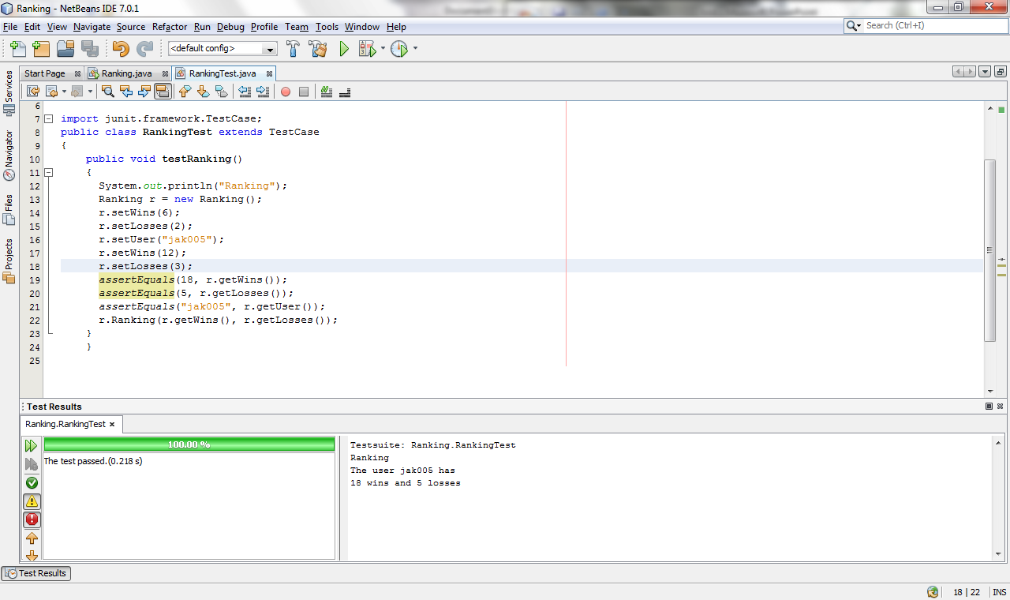
TDD Documentation

Slide 6
TDD Documentation
import junit.framework.TestCase;
@author Eric
public class LoginTest extends TestCase {
public void testEmptyInput() {
Login log = new Login();
assertEquals("Invalid username or pswd", log.checkInput("", ""));
}
public void testWrongInput(){
String user = "user";
String pswd = "pswd";
Login log = new Login();
String expResult = "Invalid username or pswd";
String result = log.checkInput(user, pswd);
assertEquals(expResult, result);
}
public void testCapitalizedInput(){
String user = "FireUser";
String pswd = "Pswd";
Login log = new Login();
String expResult = "Invalid username or pswd";
String result = log.checkInput(user, pswd);
assertEquals(expResult, result);
}
public void testRightInput(){
String user = "fireUser";
String pswd = "pswd";
Login log = new Login();
String expResult = "Logged In";
String result = log.checkInput(user, pswd);
assertEquals(expResult, result);
}
The code to your left is what we used to test the logic of our login screen as we produced it, yet another form of TDD.

Slide 7
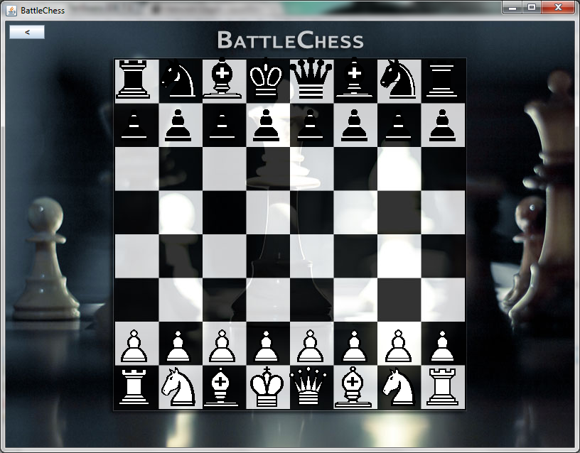

Slide 8
Current Status of the Game
The game currently has the capabilities to:
Show Register Button
Show Login Button
Show board and pieces
Show Rank Button
Shows Credits

Slide 9
Plan for Next Release
Fine tune the Register, Login, Rank with the database
Add specified functionality to the pieces
Create database components for the Board and Pieces

Slide 10
Test Cases for Next Release
Test the movement of the pieces.
Make sure each moves with it’s specific functionality.
Test database connection.

